Slide 1
Starting Out Right
OPLA’s Survey on the Registration of New Members

Slide 2
Gillian Byrne
Manager - Toronto Reference Library
Toronto Public Library
OPLA Councillor - Toronto
Douglas Davey
Manager of Children’s and Youth Services
Halton Hills Public Library
OPLA Vice President

Slide 3
OPLA Research &
Evaluation Committee
Congratulations on their inaugural project!

Slide 4
What we set out to do in this project
Document current practices
Identify trends in registration
Develop best practices
We developed the survey partly as a result of conversations within OPLA Council around different registration practices
We wanted to understand registration practices and see if there were geographic/size related themes
The next step and ultimate goal for this project is to develop best practices for OLPA libraries

Slide 5
DISCUSSION: Why do we register people at all?

Slide 6
DISCUSSION: Why do we register people at all?
Legislation (PLA)
Materials control
Statistics
Identification

Slide 7
DISCUSSION: What do we consider when we register new patrons?

Slide 8
DISCUSSION: What do we consider when we register new patrons?
Legislation
PLA
AODA
MFIPPA
Municipal Act
Policy
Procedure
Equity and Inclusion
Common practice
First impressions

Slide 9
Respondents

Slide 10
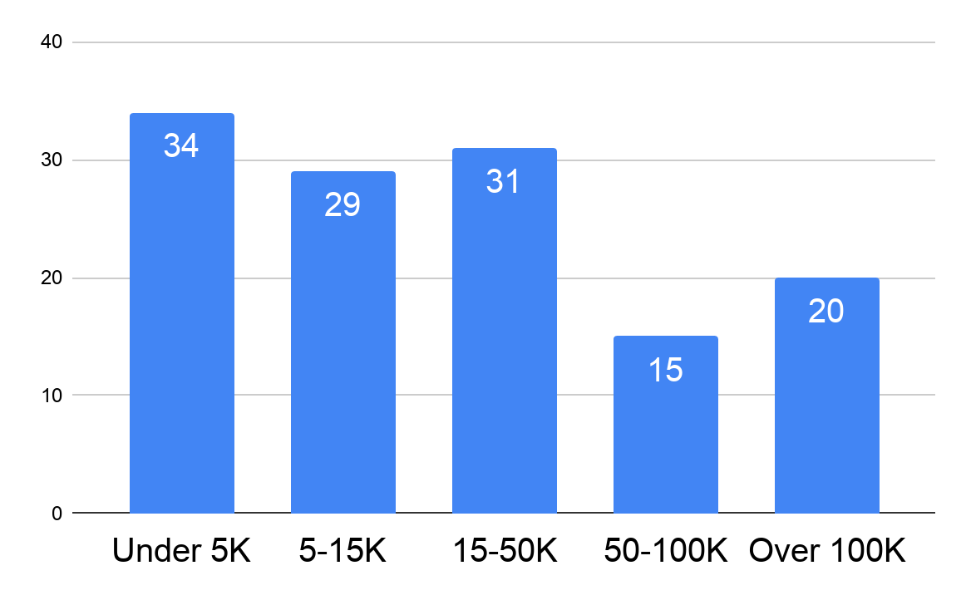
Responses by Pop.

Slide 11
Identification & Address

Slide 12
INSIGHT 1 - Most systems (76%) require both proof of ID and address
Driver’s License is preferred
Other ID is accepted
Smaller communities are the most flexible

Slide 13
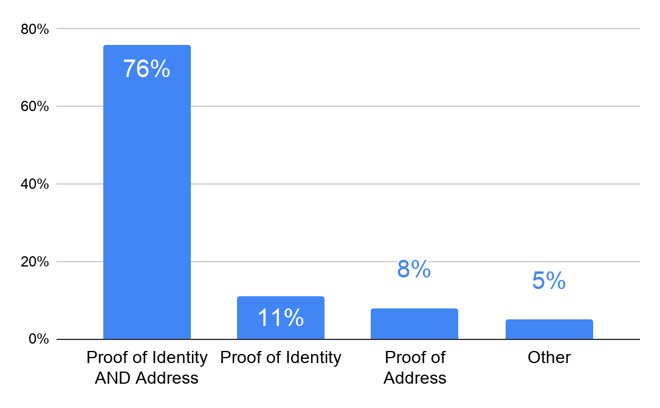
Proof of ID and Address

Slide 14
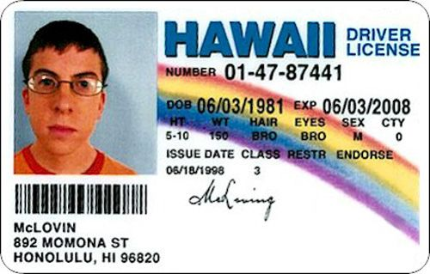
ACCEPTABLE ID

Slide 15
ACCEPTABLE ADDRESS

Slide 16
Name, Age & Gender

Slide 17
INSIGHT 2 - Most systems (74%) allow for personal preference of recorded name
Larger systems require closer matching to ID, while smaller systems are more flexible

Slide 18
INSIGHT 3 - Most systems (65%) ask for date of birth
Of that 65%, 17% of libraries report asking for DOB, but having some form of opt out/decline option
Some libraries ask for DOB only for specific age groups (e.g., children, seniors)

Slide 19
INSIGHT 4 - Most systems (81%) do not ask for gender
Only 3% of libraries require gender as a mandatory field, while 10% reported asking for gender but with an opt-out decline option
A few comments indicated that filling in this field is left to staff judgement

Slide 20
Virtual Registration

Slide 21
INSIGHT 5 - Most systems (77%) do not allow for virtual registration
Virtual registration = registration from home
22% who said “no” are thinking about it
Those that do allow are in 15,000+ communities
96% who said “yes” offer limited or no services until an in-person visit

Slide 22
INSIGHT 6 - Most systems (78%) do not offer virtual cards
Those that do tend to come from larger systems
A majority of systems (62%) that offer virtual cards have restrictions (e.g. no physical borrowing)

Slide 23
INSIGHT 7 - A very slim majority (52%) allows for off-site registration
Most (60%) connect to the ILS via a tablet or laptop
Largest “no” group = < 5k
Largest “yes” group = 15-50K

Slide 24
Non-Resident Membership

Slide 25
INSIGHT 8 - The larger the system, the more likely they are to offer memberships to non-residents
Including taxpayers, employees and students in the catchment area, & members of neighbouring libraries
Systems are willing to be flexible
Membership length and fee are varied
Special rules for tourists, students, summer residents

Slide 26
INSIGHT 9 - A slight majority of systems (58%) offer temporary cards
33% charge, 26% don’t charge, 42% have no temp cards
Larger systems less likely to charge for temp cards
Smaller systems more likely to offer temp cards
Limitations varied

Slide 27
Form Retention
& CASL

Slide 28
Form Retention
& CASL

Slide 29
INSIGHT 10 - Systems are divided on retention of forms
Keepers are split between paper and electronic
Length of retention varies widely
Smaller systems more likely to use paper, and vice versa

Slide 30
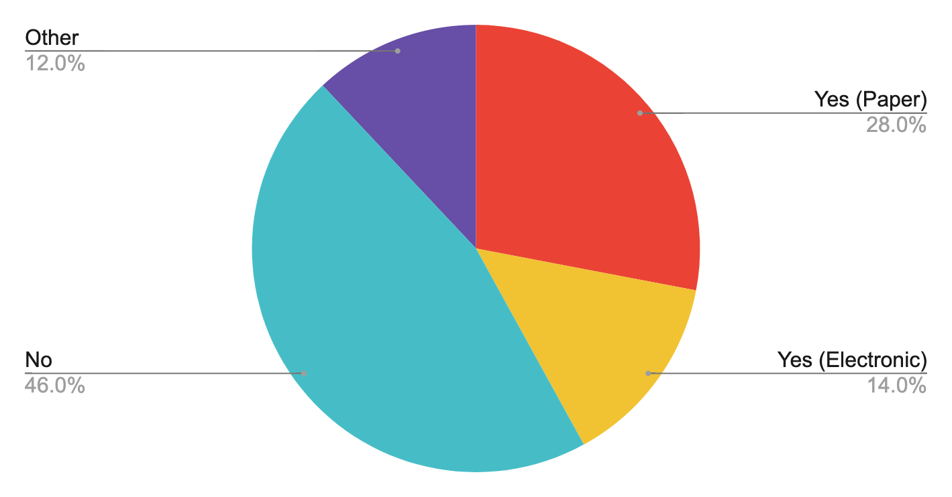
Retention of forms

Slide 31
INSIGHT 11 - Most systems ask patrons to opt-in to emails, in compliance with CASL
71% ask patrons to opt-in
Smaller systems are less likely to ask registrants to opt in or out

Slide 32
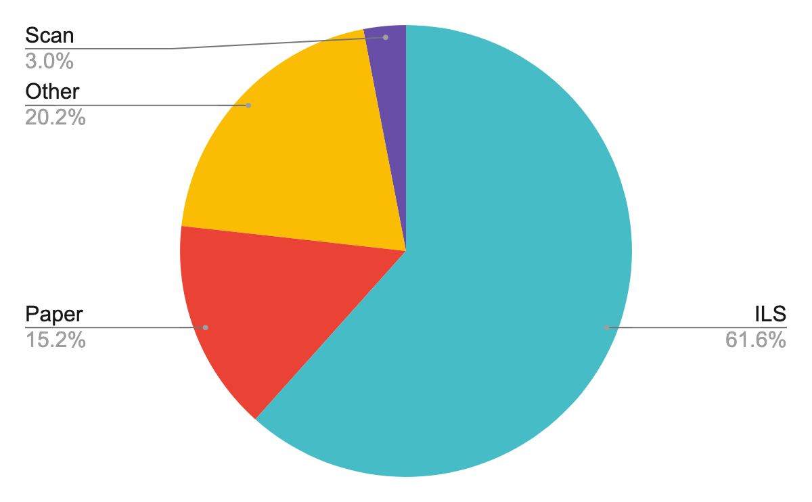
CASL Opt-In Tracking

Slide 33
Next Steps

Slide 34
INSIGHT 12 - People were happy we asked!
“I'm glad you are doing this survey, looking forward to more clarity on how we should be managing consent and best practices”
“Thanks, this gave me a lot to think about why we do some of the things we do”

Slide 35
Review, discussion, publication
Further review of the survey findings
Discussion opportunities (such as this conference, online options)
Eventual discussion paper published by OPLA (?)

Slide 36
Questions?
Gillian Byrne and Douglas Davey

